Slide 1
High-Speed Stock Trading

Slide 2
Trading Simulation Background Information
RAM Corp. is a Top Tier ERP software vendor which stock is traded around $100.
Suddenly it is reported that the CEO of RAM Corp CEO has gone missing, stock price plunge as traders scrambled to sell off RAM’s stocks

Slide 3
Trading Simulation
Rumour has surfaced that the CEO is in fact alive and sound and will be returning to the office.
Now as traders, your mission is to buy RAM Corp’s stock at the lowest price possible.

Slide 4
Trading Simulation
Please open the following webpage:
http://www.m-flat.com/ramcorp.html
(DON’T click “Buy This Stock” button!)

Slide 5
Trading Simulation
Wait until you see the lowest price at the ticker
….then click “Buy This Stock”!
Price
100
Lowest
Click!
Time

Slide 6
Trading Simulation
Check your ranking
As you can see, we purchased RAM Corp’s stock at the lowest price possible. This is because we can place the order
0.03 sec ahead of you!!

Slide 7
History of Stock Trading
The NYSE took shape in New York City in the 1790s.
The NYSE introduced in 1867 a stock ticker. (telegraphic receiving instrument)
After 1878, due to telephone invention, the trading time was reduced from 15 minutes to less than 60 seconds.
1800
15min
1900
60sec
2000

Slide 8
History
In 1978 was inaugurated the Inter-market Trading System (ITS). This system used computers to connect the NYSE to other stock exchanges.
In 1998: electronic exchanges were authorized.
Currently: companies use powerful algorithms
1800
15min
1900
60sec
2000
0.04sec
Notes:
8

Slide 9
High-Speed stock trading
Computer programs that order stocks without human intervention
Directly connected to stock exchanges in the world
It gets real-time information: stock price, trading volume, trading cost
The system finds out the price difference between exchanges.
It also defines the best timing and amount of transactions.
Notes:
9

Slide 10
High-Speed Stock Trading
Real time analysis
Simulation
Performance
High-speed data transfer

Slide 11
High Speed Stock Trading
Percentage of System-Trading in Trading volume is increasing: from 35% to 73%
Investment Banker, Hedge funds gain $210 billion in profit from the high speed trading.

Slide 12
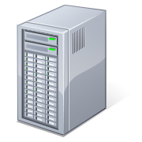
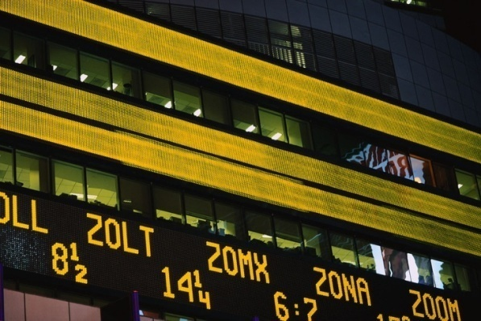
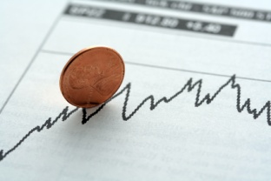

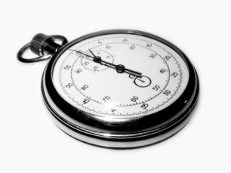

System Trading -Infrastructure-
Stock Price Data
Place order
Trading system
Stock Exchange
Decide
When to sell
What amount to sell
Grid-Based
High Performance
System
Simulation
Performance
Get
Current price
Current trading
volume
Direct connection
to Stock Exchange
High-speed
connection
Real-Time
Data Transfer

Slide 13

System Trading vs Discretionary Trading
Investors
Stock Brokers
Stock Exchange
1-5sec
1sec
1sec
1sec
Companies with System trading
(Hedge Funds, Investment Bank)
0.03sec
0.004-0.03sec

Slide 14
Infrastructure
Grid Computing
Subset of Cloud computing
Scalable system: Clusters of networked PC
Processing in Parallel
Allocate Task
Simulation Result

Slide 15
Grid + SOA = GOA(Grid Oriented Architecture)
NOT one system = one software.
Risk
manager
System-Trading
Application
Resource
Accounting
System
Database
Risk Management
CPU
Trader
Bookkeeper
System User
Application
Layer
Virtualized
Resources

Slide 16
Case Study –Goldman Sachs
Developed original system since 1980s
Generated more than $4 billion per year
Expanded system worldwide
GSAT (Goldman Sachs Algorithm Trading)
Providing customers high-speed Trading

Slide 17
Case Study –UBS
European leader of system trading
Developed grid system in 2005
Operating system with 2,000 PCs
Has excess capacity
proving cloud services (System-trading)
to customers

Slide 18
Flash Trading
Goldman Sachs can get price info 0.03 sec faster than other traders.
With high-speed trading system, they can do front-running.
(Place their order before customer’s)
FRB will restrict fast access to Stock Exchange

Slide 19
Cloud computing in High-Speed Trading
Nasdaq DataStore
Amazon S3 technology (Saas)
Providing real-time price / trade info needed to system trading
New technology boost competition

Slide 20
Takeaway
System-Trading enables traders to place order in mili-seconds.
Technology improvement has boosted competition.
Competition in High-Speed Trading is ongoing… until reaching 0.00001sec?

Slide 21
Q&A
Any question?

Slide 22
Appendix -Trading Simulation-
Ajax+PHP
PHP+MySQL
Price info
Transaction
Data
Auto-Price
Update
Application
Server
Database
Server
(Mysql)

